Slide 1
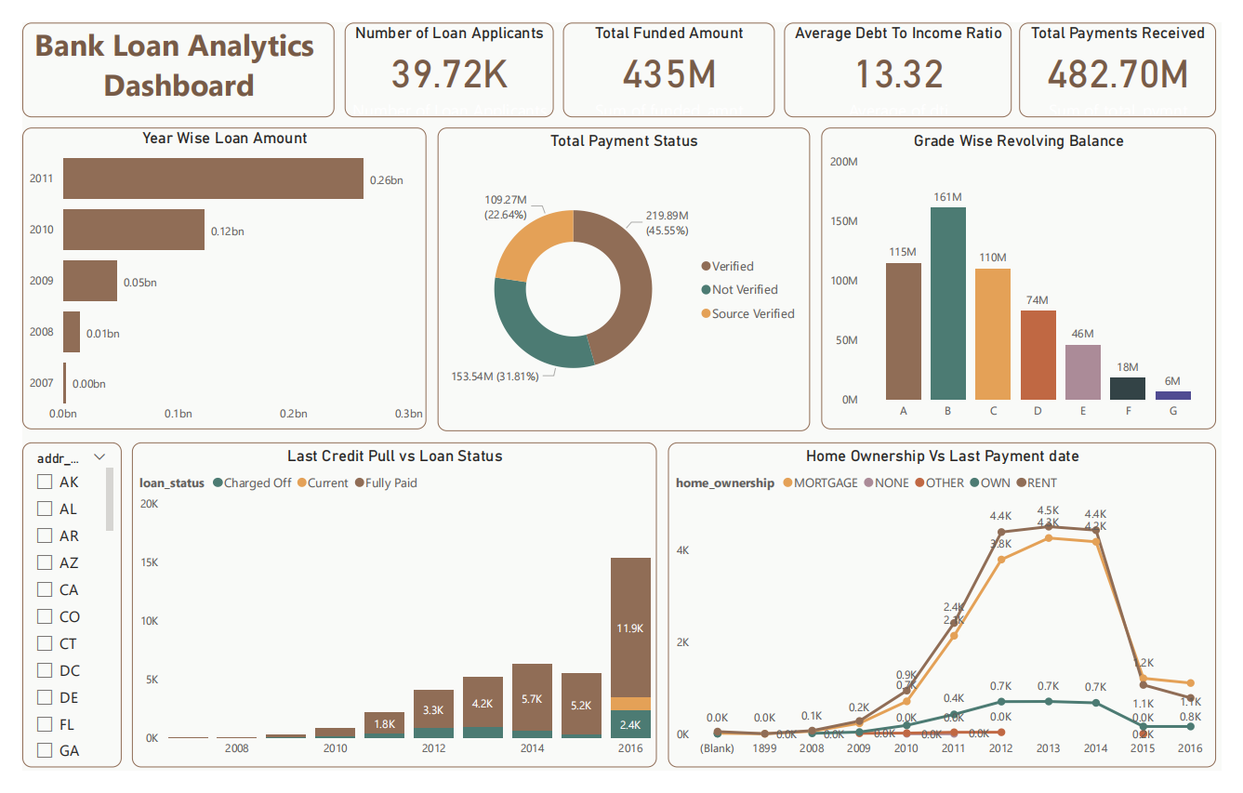
Bank Loan Analytics Project

Slide 2
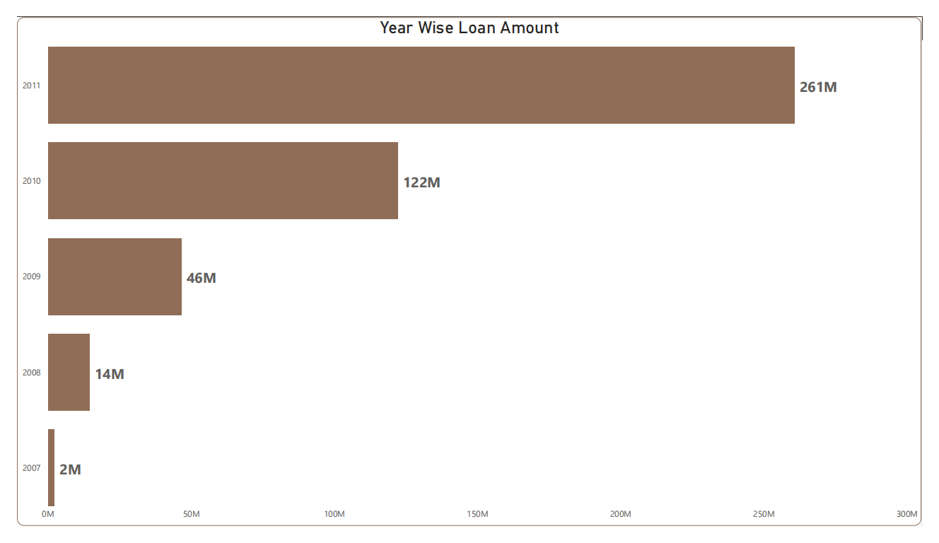
Year Wise Loan Amount
The average loan amount has been increasing over time.
This could be due to a number of factors, such as rising house prices or increasing demand for credit.

Slide 3
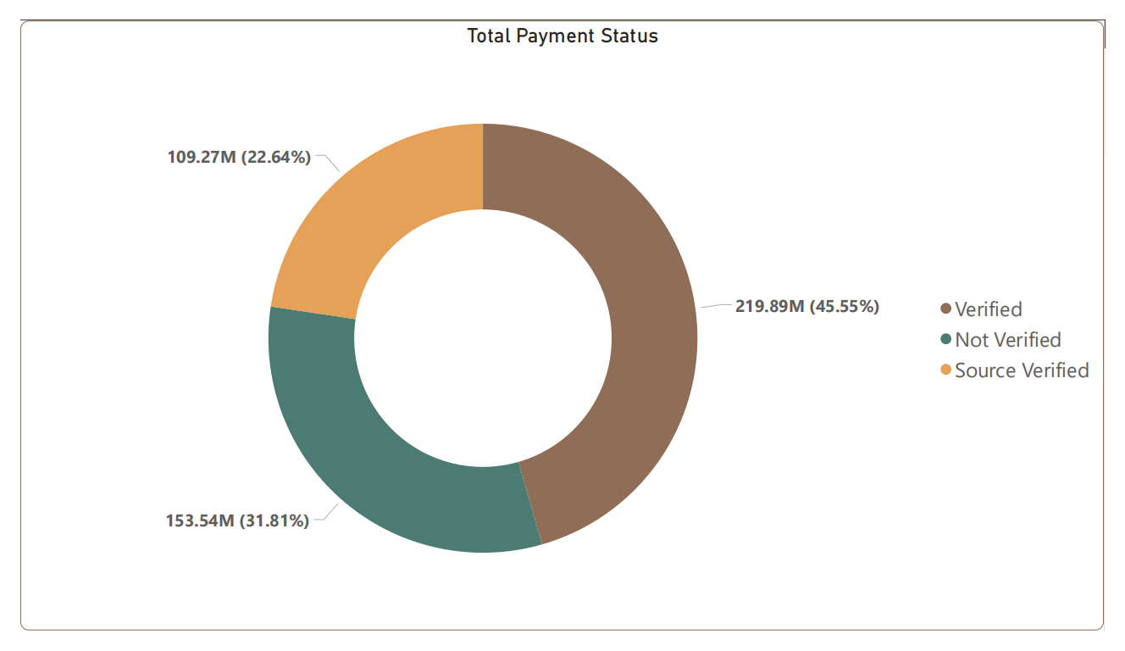
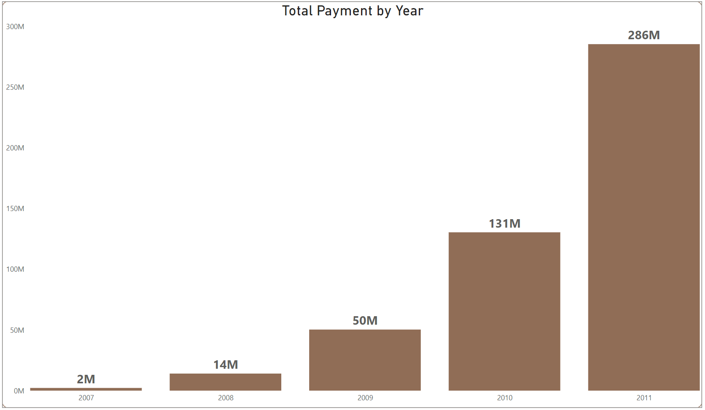
Total Payment Status
The total amount of payments made on loans has also been increasing over time.
This suggests that borrowers are generally making their payments on time.
The percentage of loans that have been verified is high.
This means that the bank has been able to verify the borrowers' income and assets, which reduces the risk of default.

Slide 4
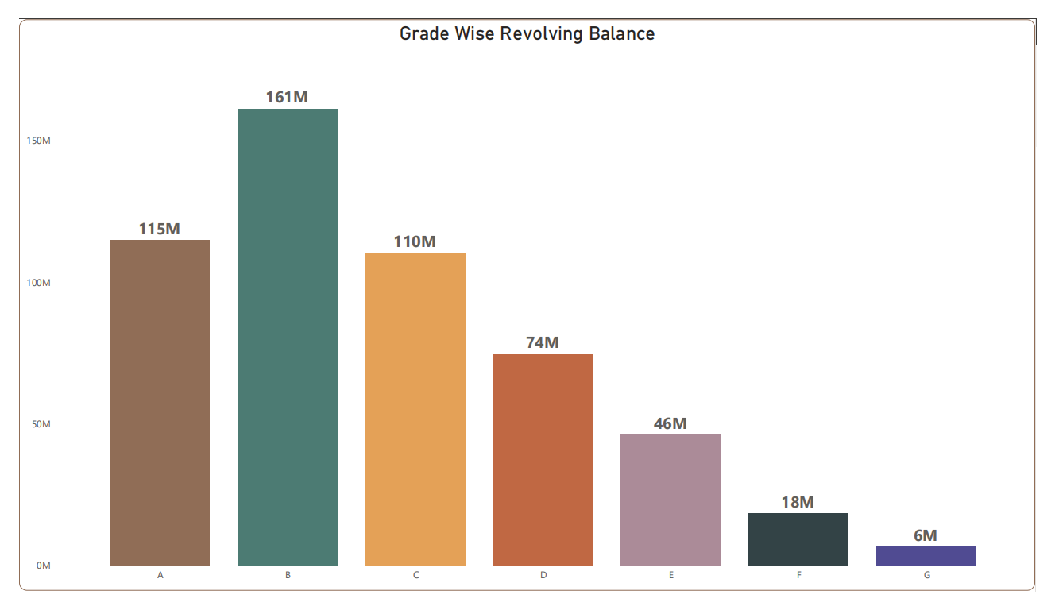
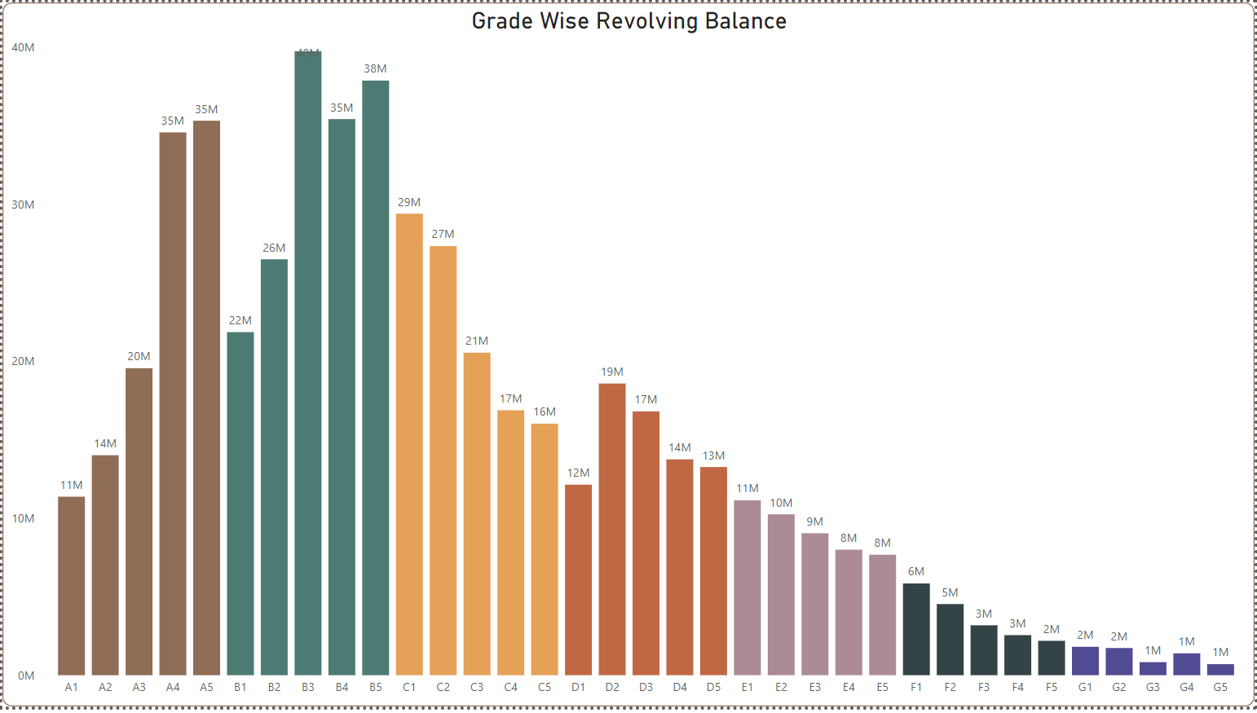
Grade and Sub-Grade wise Revolving Balance
The average revolving balance is lower for loans in the lower grades.
This suggests that borrowers with lower credit scores are more likely to have high debt levels.

Slide 5
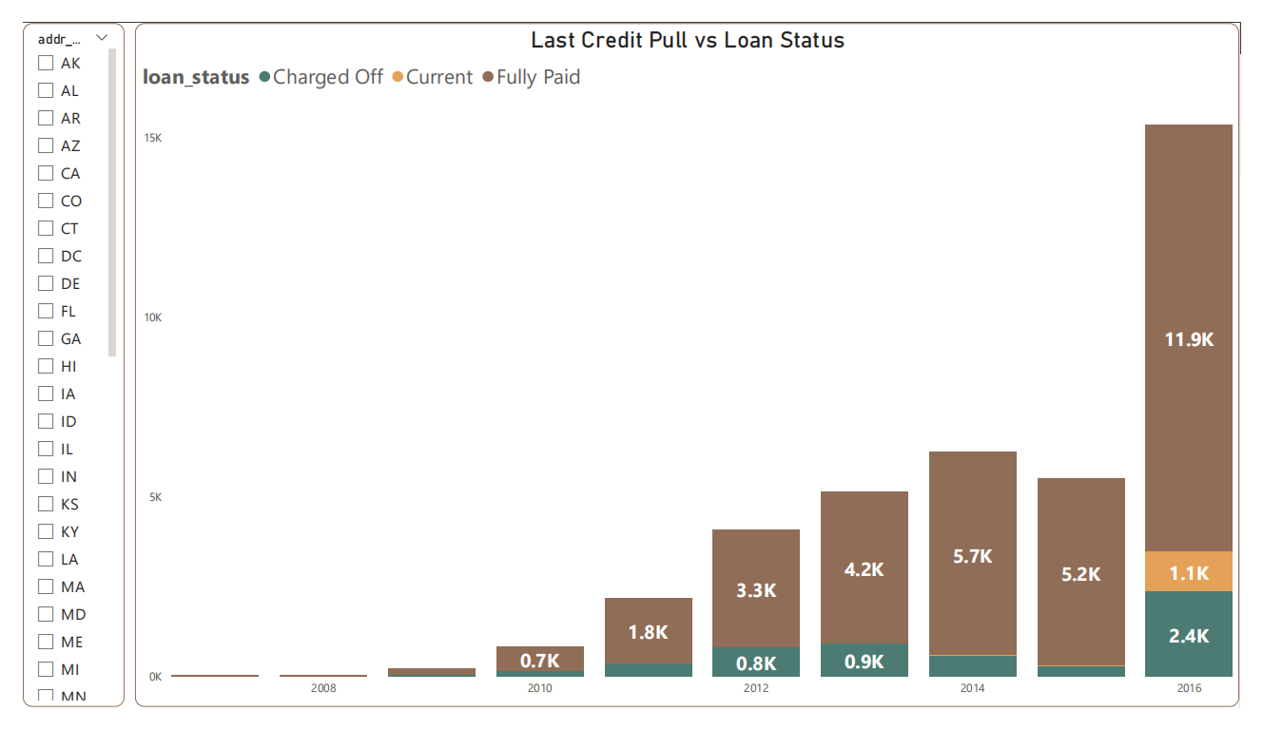
State and Last credit Pull Date wise Loan Status
The state with the highest percentage of loans in good standing is California.
This is likely due to the strong economy in California.
The last credit pull date is a good indicator of the borrower's creditworthiness.
Loans that were pulled recently are more likely to be in good standing than loans that were pulled a long time ago.

Slide 6
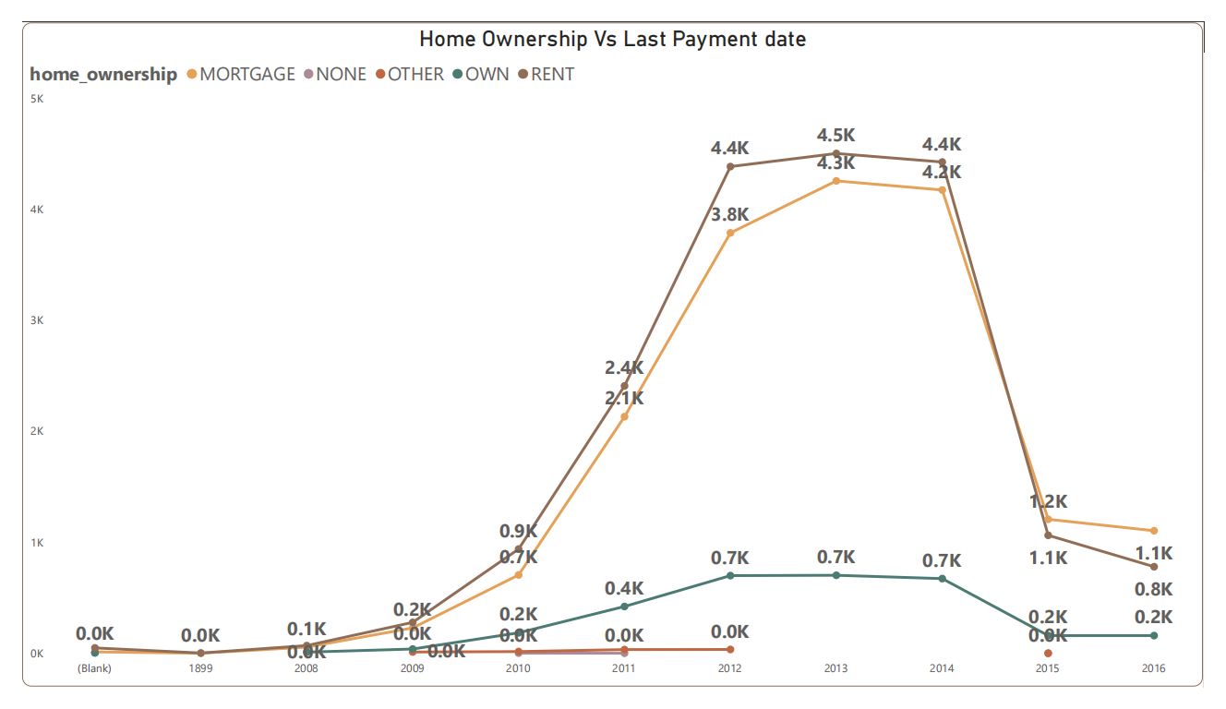
Last Payment Date wise Home Ownership
There is a clear difference in the last payment dates for borrowers who own their homes and those who rent.
Homeowners tend to make their payments more consistently than renters.
Overall, the bank loan data dashboard provides a valuable overview of the bank's lending portfolio.
It can be used to track the portfolio's performance over time and identify areas for improvement.

Slide 7
Conclusion and Insights
The dashboard shows that the bank's lending portfolio is concentrated in California.
This means that the bank is exposed to the risk of a housing market downturn in California.
The dashboard also shows that the bank's lending portfolio is skewed towards borrowers with lower credit scores.
This means that the bank is exposed to the risk of default.
These insights can be used by the bank to manage its lending portfolio and mitigate its risks.
For example, the bank could focus on lending to borrowers in other states or to borrowers with higher credit scores.

